Slide 2
OBJECTIVES
Describe how to create a remote branch
Describe how to pull from a remote connection

Slide 3
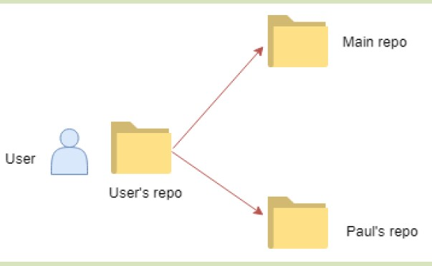
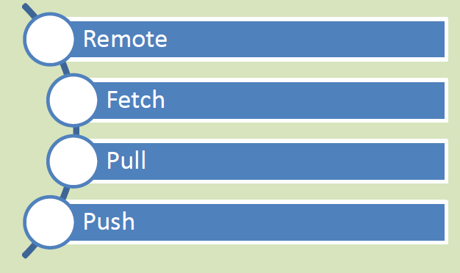
REMOTE BRANCHES IN GIT 1-2
Remote Connections in Git
Synchronization mechanism

Slide 4
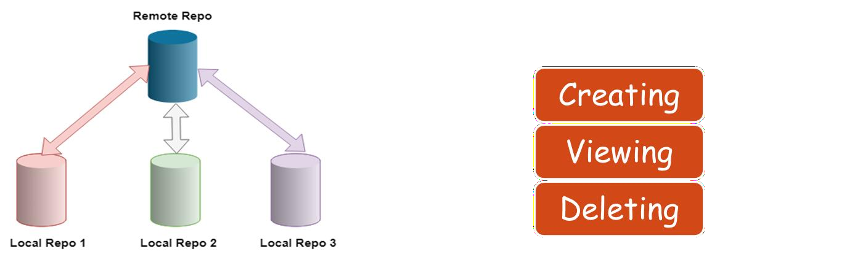
REMOTE BRANCHES IN GIT 2-2
Setting Up and Deleting Remote Branches
Remote Connections in Git
These tasks can be done using various commands.

Slide 5
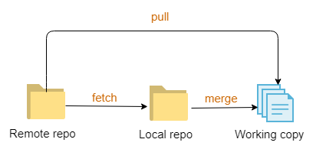
PULLING IN GIT 1-2
Mechanism of Pulling in Git
Approaches to Pulling

Slide 6
PULLING IN GIT 2-2
Mechanism of Pulling in Git
Approaches to Pulling
Pulling
Pull
Pull without commit
Verbose Pull

Slide 7
SUMMARY
A remote is essentially a connection that is established with an entity on
a different machine. It carries out several syncing responsibilities.
Git allows users to share branches, which means that an entire series of commits can be shared and user’s local copy of the repository can be
synced with project’s main repository.
Synchronization is achieved in Git via remote connections.
Fetching pulls all the data from the specified remote project which are
not available with the user yet.
Pulling facilitates collaboration between various developers.
Remotes can be inspected or renamed as per requirements and removed when not required any further.

